Slide 1

Data Structures and its Applications
Dinesh Singh
Department of Computer Science & Engineering

Slide 2

Data structures and its applications
Application of stacks– Functions, nested functions and Recursion
Dinesh Singh
Department of Computer Science & Engineering

Slide 3
Data Structures and its Applications
Application of stacks – Functions, nested functions
Activation record :
When functions are called, The system (or the program) must remember the place where the call was made, so that it can return there after the function is complete.
It must also remember all the local variables, processor registers, and the like, so that information will not be lost while the function is working.
This information is considered as large data structure . This structure is sometimes called the invocation record or the activation record for the function call.

Slide 4
Data Structures and its Applications
Application of stacks – Functions, nested functions and Recursion
Suppose that there are three functions called A,B and C. M is the main function.
Suppose that A invokes B and B invokes C. Then B will not have finished its work until C has finished and returned. Similarly, A is the first to start work, but it is the last to be finished, not until sometime after B has finished and returned.
Thus the sequence by which function activity proceeds is summed up as the property last in, first out.
The machine’s task of assigning temporary storage area (activation records ) used by functions would be in same order (LIFO).
Since LIFO property is used, the machine allocates these records in the stack
Hence a stack plays a key role in invoking functions in a computer system.

Slide 5
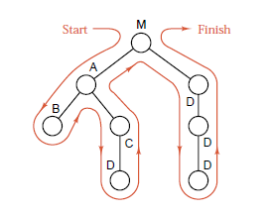
Data Structures and its Applications
Application of stacks – Functions, nested functions
Example :
Consider the following showing the order in which the functions are invoked

Slide 6
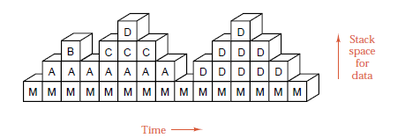
Data Structures and its Applications
Application of stacks – Functions, nested functions
The Sequence of stack frames of the activation records of the function calls is given below. Each vertical column shows the contents of the stack at a given time, and changes to the stack are portrayed by reading through the frames from left to right.

Slide 7
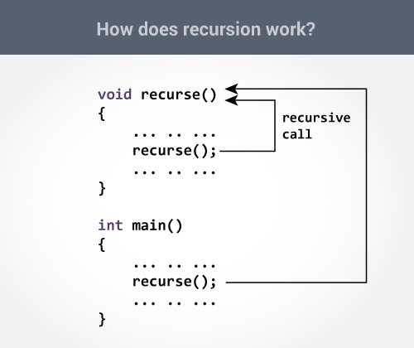
Data Structures and its Applications
Application of stacks – Recursion
Recursion :
Recursion is a computer programming technique involving the use of a procedure, subroutine or a function.
The process in which a function calls itself directly or indirectly is called recursion and the corresponding function is called as recursive function.

Slide 8
Data Structures and its Applications
Application of stacks – Recursion
How a particular problem is solved using recursion?
The idea is to represent a problem in terms of one or more smaller problems.
A way is found to solve these smaller problems and then build up a solution to the entire problem.
The sub problems are in turn broken down into smaller sub problems until the solution to the smallest sub problem is known.
The solution to the smallest sub problem is called the base case.
In the recursive program, the solution to thebase case is provided

Slide 9
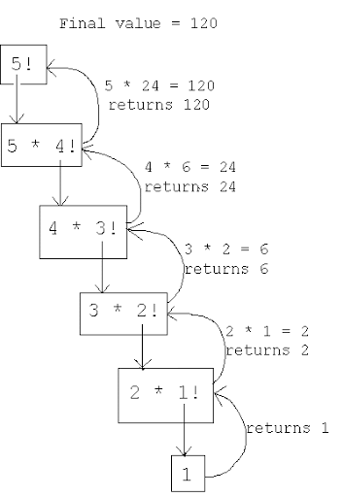
Data Structures and its Applications
Application of stacks – Recursion
Example 1: Factorial of a Number n
Recursive definition :
n! = 1 if n=1
n!= n * (n-1)! If n>1

Slide 10
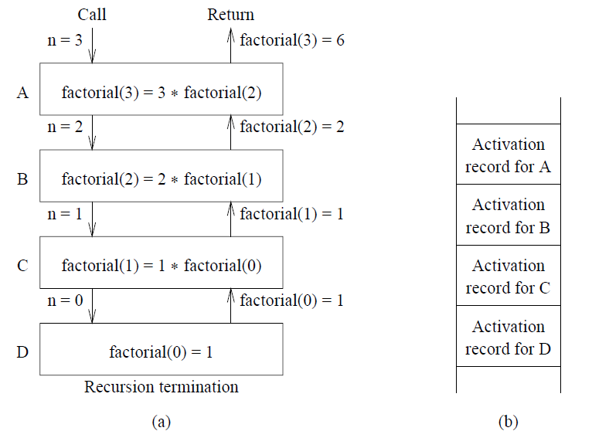
Data Structures and its Applications
Application of stacks – Recursion
Recursive function to compute factorial of n
factorial(n)
{
int f;
if(n==0)
return 1;
f=n*factorial(n-1);
return f;
}

Slide 11
Data Structures and its Applications
Application of stacks – Recursion
Recursive function to find the product of a*b
a*b= a if b=1;
a*b = a*(b-1)+a if b >1;
To evaluate 6 * 3
6*3 = 6*2 + 6 = 6*1 + 6 + 6 = 6 + 6 + 6 = 18
multiply(int a, int b)
{
int p;
if (b==1)
return a
p= multiply(a,b-1) + a;
return p;
}

Slide 12
Data Structures and its Applications
Application of stacks – Recursion
Fibonacci Sequence
The fibonacci sequence is the sequence of integers
1, 1, 2, 3, 5, 8, 13, 21, 34...
Each element is the sum of two preceding elements
If we consider fib(0) = 1 and fib(1)=1
then recursive definition to compute the nth element in the sequence is
fib(n) = n if n=0 or n=1
fib(n) = fib(n-1) + fib(n-2) for n >=2

Slide 13
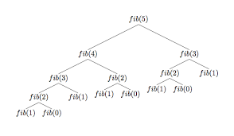
Data Structures and its Applications
Application of stacks – Recursion
Recursive function to compute the nth element in the Fibonacci Sequence
fib(int n)
{
int x,y;
if ( (n==0) || (n==1))
return n;
x= fib(n-1) ;
y=fib(n-2);
return x+y;
}

Slide 14
Data Structures and its Applications
Application of stacks – Recursion
Recursive function to find the sum of elements of an array
int sum(int *a, int n)
//a is pointer to the array, n is the index of the last element of the array
{
int s;
if(n==0) // base condition
return a[0];
s= sum(a,n-1) + a[n]; // compute sum of n-1 elements and add the nth element
return s;
}

Slide 15
Data Structures and its Applications
Application of stacks – Recursion
Recursive function to display the elements of the linked list in the reverse order
int display(struct node *p)
{
if(p->next!=NULL)
display(p->next)
printf(“%d “,p->data);
}

Slide 16
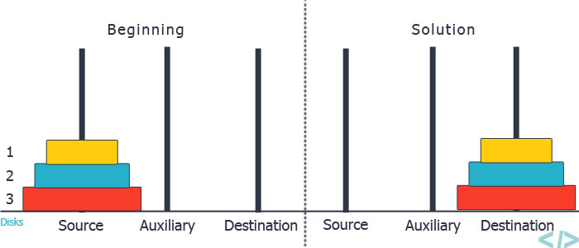
Data Structures and its Applications
Application of stacks – Recursion
Tower of Hanoi
Three Pegs A, B and C exists. N disks of differing diameters are placed on peg A. The Larger disk is always below a smaller disk. The objective is to move the N disks from Peg A to Peg C using Peg B as the auxillary peg

Slide 17
Data Structures and its Applications
Application of stacks – Recursion
Tower of Hanoi – recursive solution
If a solution to n-1 disks is found, then the problem would be solved. Because in the trivial case of one disk, the solution would be to move the single disk from Peg A to Peg C.
To move n disks from A to C , the recursive solution would be as follows
If n=1 move the single disk from A to C and stop
Move the top n-1 disks from A to B using C as auxillary
Move the remaining disk from A to C
Move n-1 disks from B to C using A as the auxillary

Slide 18
Data Structures and its Applications
Application of stacks – Recursion
Recursive function for Tower of Hanoi
void tower(int n,char src,char tmp,char dst)
{
if(n==1)
{
printf("\nMove disk %d from %c to %c",n,src,dst);
return;
}
tower(n-1,src,dst,tmp);
printf("\nMove disk %d form %c to %c",n,src,dst);
tower(n-1,tmp,src,dst);
return;
}

Slide 19
Data Structures and its Applications
Application of stacks – Recursion
Recursive function for Tower of Hanoi
Solution for 4 disks
Move disk 1 from peg A to peg B
Move disk 2 from peg A to peg C
Move disk 1 from peg B to peg C
Move disk 3 from peg A to peg B
Move disk 1 from peg C to peg A
Move disk 2 from peg C to peg B
Move disk 1 from peg A to peg B Solution for moving 3 disks from A to B
Move disk 4 from peg A to peg C Move 4th disk from A to C
Move disk 1 from peg B to peg C Solution for moving 3 disks from B to C
Move disk 2 from peg B to peg A
Move disk 1 from peg C to peg A
Move disk 3 from peg B to peg C
Move disk 1 from peg A to peg B
Move disk 2 from peg A to peg C
Move disk 1 from peg B to peg C

Slide 20
THANK YOU
Dinesh Singh
Department of Computer Science & Engineering
dineshs@pes.edu
+91 8088654402

